Slide 1
Lecture 8: Binary Search tree
Keren Zhu
kerenzhu@cse.cuhk.edu.hk

Slide 2
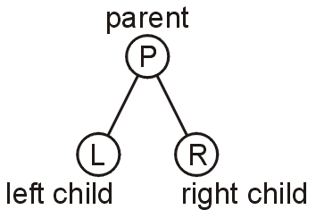
Binary tree
A binary tree is a restriction where each node has exactly two children:
Each child is either empty or another binary tree
The children of a parent node are left and right subtrees

Slide 3
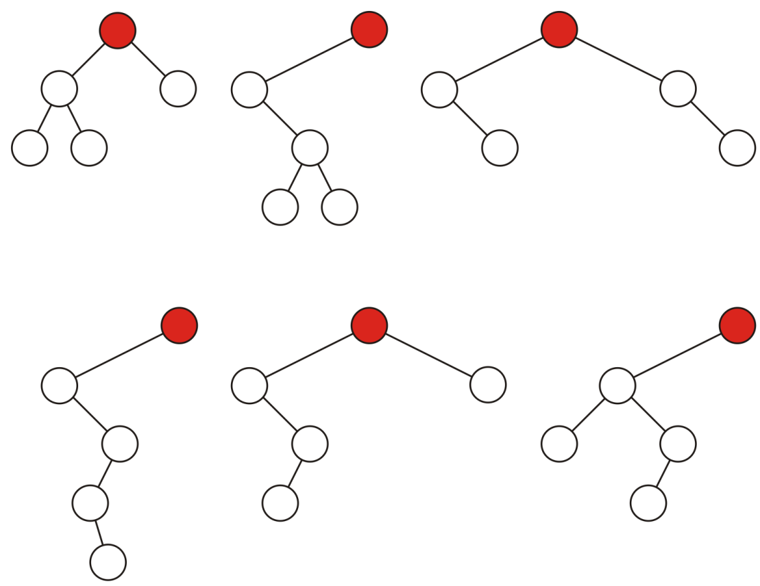
Different binary trees
Binary trees can be very different in their structures

Slide 4
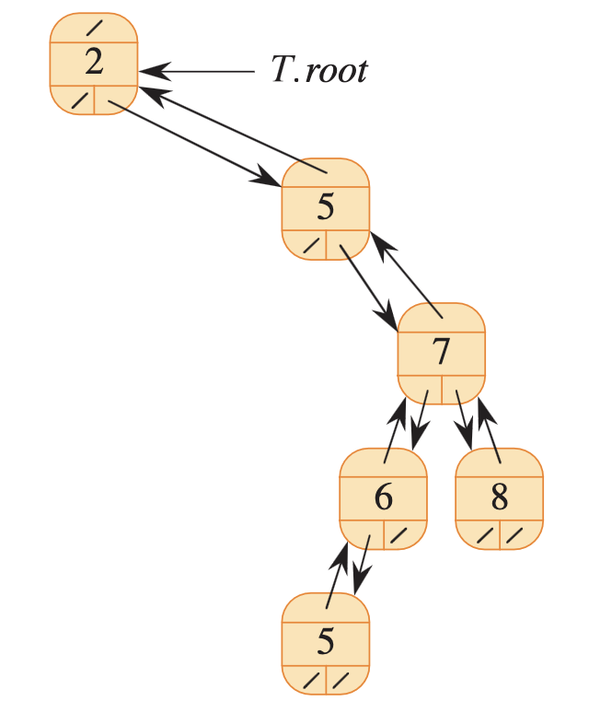
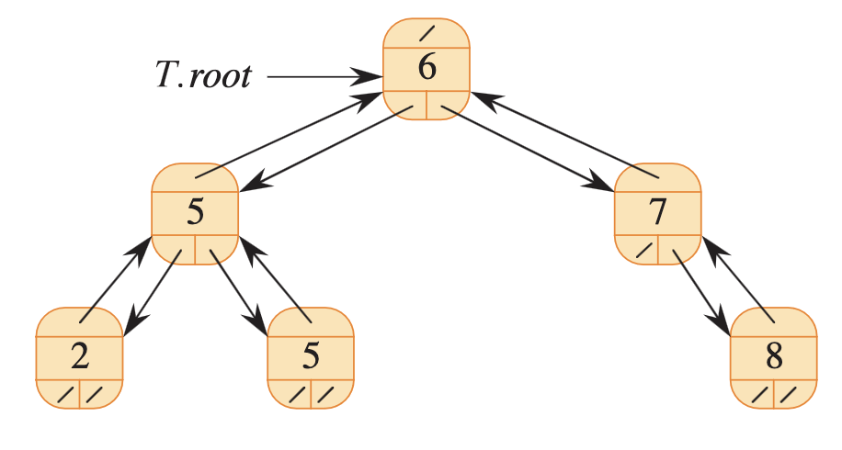
Binary search tree
A binary search tree (BST) is a binary tree where：
Each node contains a key, such as an integer
For each internal node u,
- its key is larger than all the keys in the left subtree;
- its key is smaller than all the keys in the right subtree
O(n) space

Slide 5
key data types
What is the requirement on the types of keys
The keys are comparable and ordered
Existing a function compare(key1, key2)
Can key be equal?
Yes, but they are indistinguishable
We usually assume no duplicate values
Check how to use std::set on your own key type

Slide 6
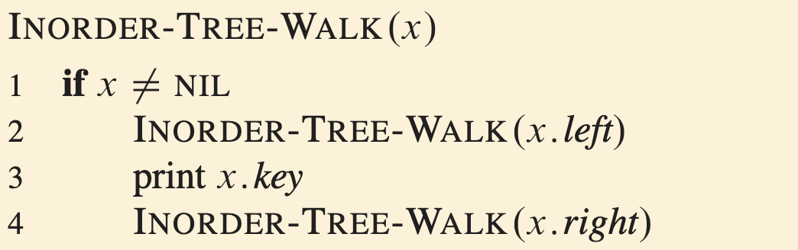
Inordered tree walk
What is the following algorithm print?

Slide 7
Inordered tree walk
What is the following algorithm print?

Slide 8
Inordered tree walk
What is the following algorithm print?

Slide 9
Inordered tree walk
What is the following algorithm print?
“2”

Slide 10
Inordered tree walk
What is the following algorithm print?
“2”

Slide 11
Inordered tree walk
What is the following algorithm print?
“2” “5”

Slide 12
Inordered tree walk
What is the following algorithm print?
“2” “5” “5”

Slide 13
Inordered tree walk
What is the following algorithm print?
“2” “5” “5”

Slide 14
Inordered tree walk
What is the following algorithm print?
“2” “5” “5” “6”

Slide 15
Inordered tree walk
What is the following algorithm print?
“2” “5” “5” “6” “7”

Slide 16
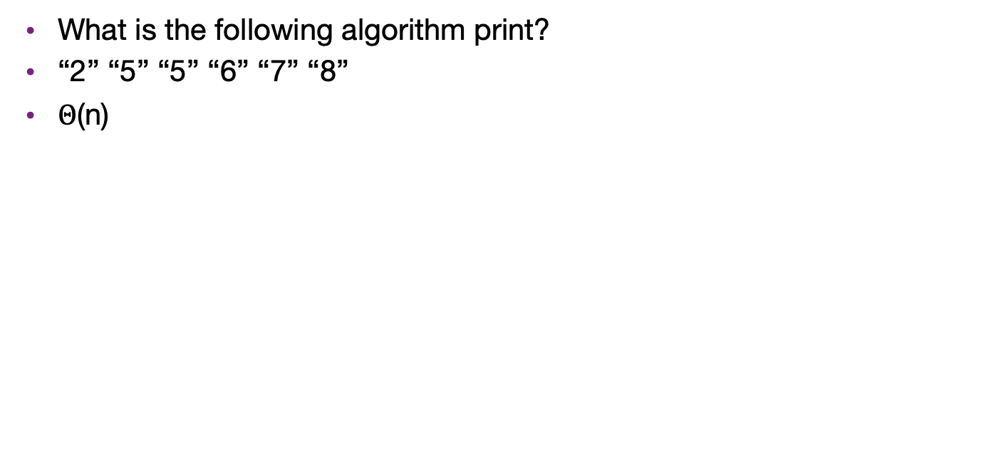
Inordered tree walk
What is the following algorithm print?
“2” “5” “5” “6” “7” “8”
$Θ$(n)

Slide 17
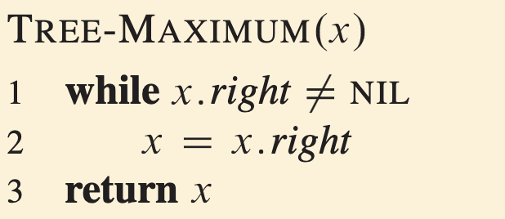
Maximum
How to find the max key value?
We know it is 8 in the tree
It is the rightmost node
What is its runtime?
O(h)

Slide 18
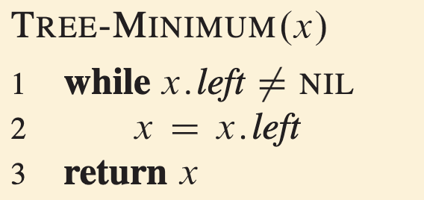
Minimum
Similarly, the min is on the left
O(h)

Slide 19
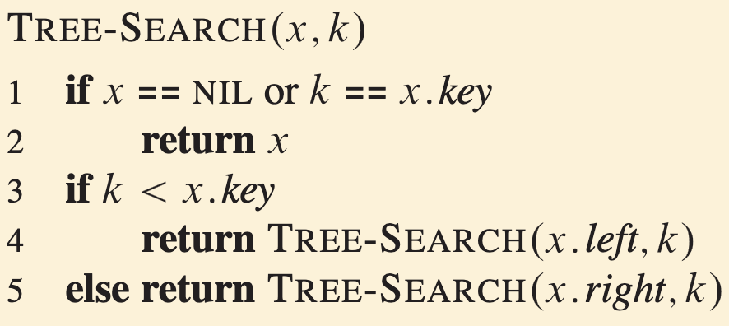
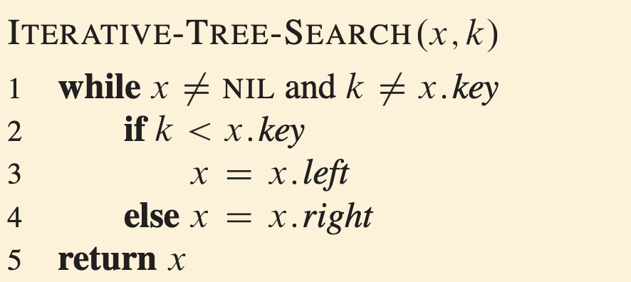
Search a general key in a BST
Leveraging the comparison, we can go faster to the target node
Two implementation: recursion and iteration
Both are O(h)

Slide 20
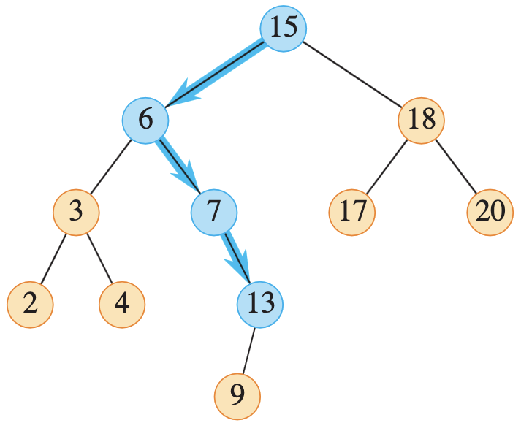
Example: search 13

Slide 21
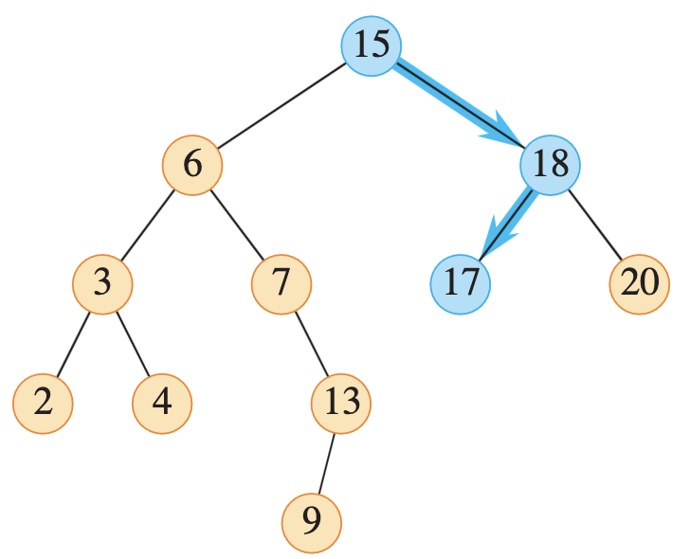
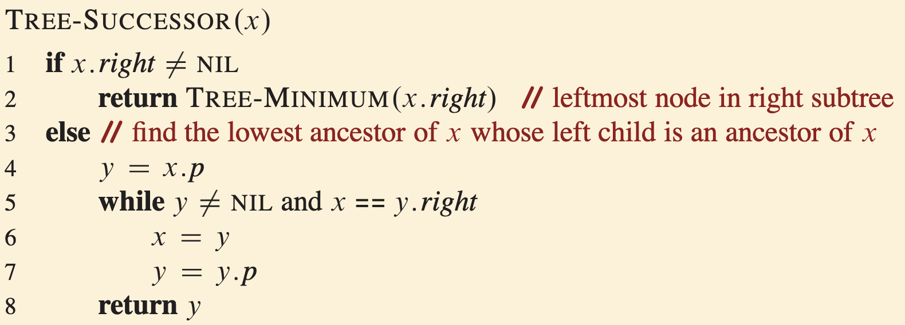
Find the successor
Where is the successor?
In the example, the successor of 15 is 17
It is the next node to be visited in a inorder tree walk
O(h)

Slide 22
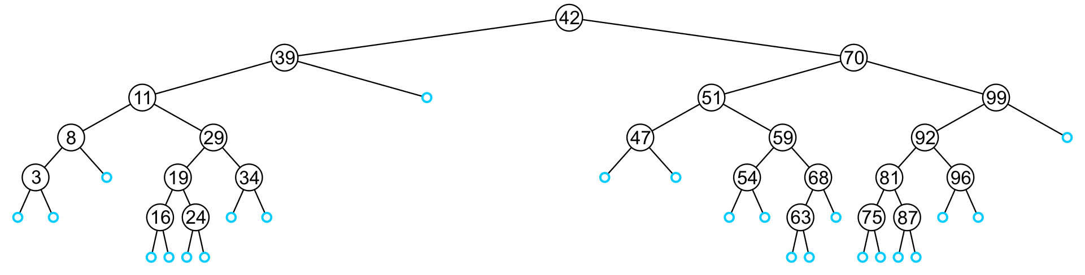
Insert
An insertion will be performed at a leaf node:
Any empty node is a possible location for an insertion
The values which may be inserted at any empty node depend on the surrounding nodes

Slide 23
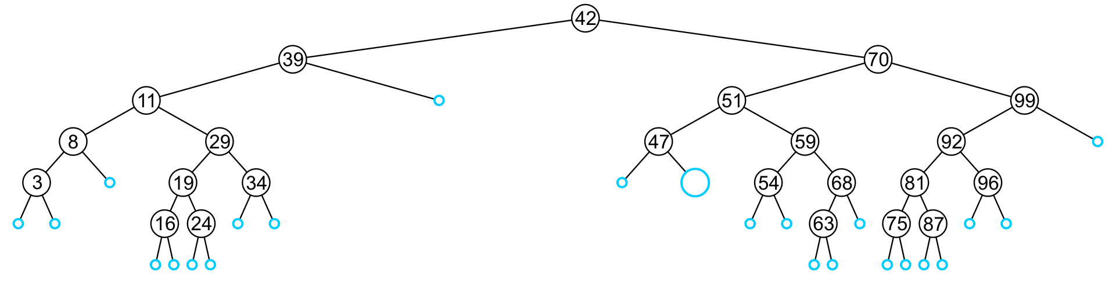
Insert
For example, this node may hold 48, 49, or 50

Slide 24
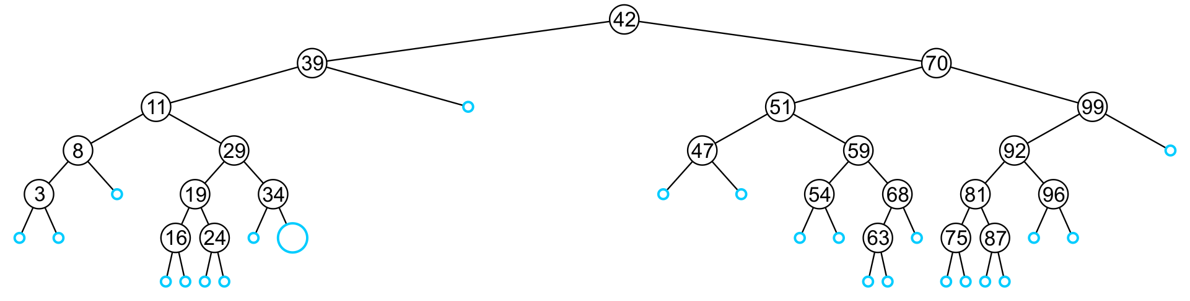
Insert
An insertion at this location must be 35, 36, 37, or 38

Slide 25
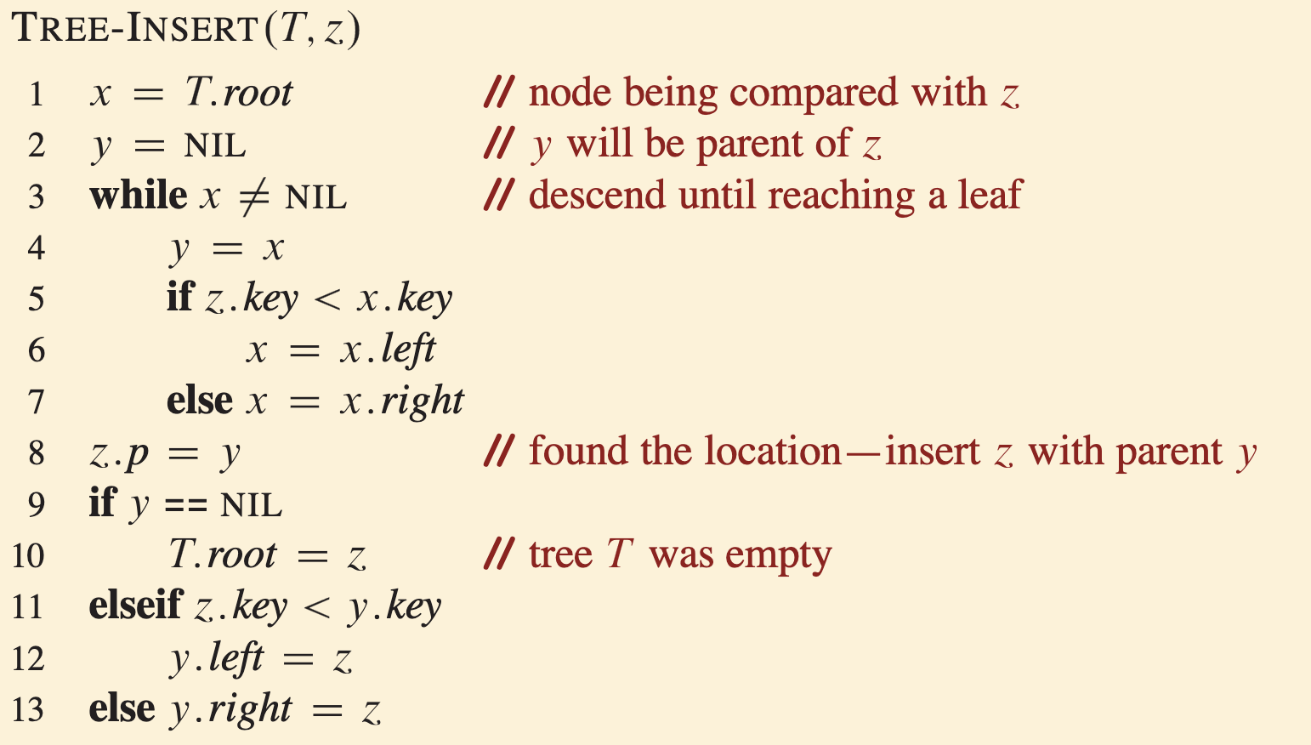
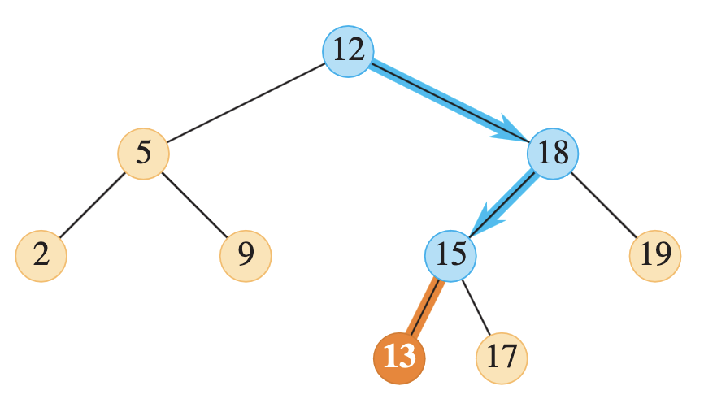
Insert algorithm
We need to search the tree and find where to insert
Example: insert 13
Runtime?
O(h)

Slide 26
Deletion
Deletion is more complicated
The node is not always a leaf node
We need to discuss different scenarios
Let’s call we want to delete z

Slide 27
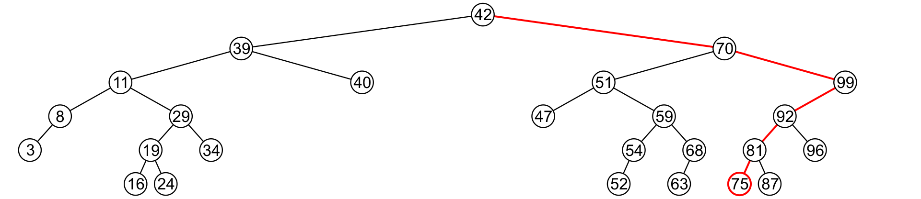
Deletion case 1: leaf
If the node to be deleted is a leaf node
Trivial: just delete the node
Replace the its parent’s child pointer to nullptr

Slide 28
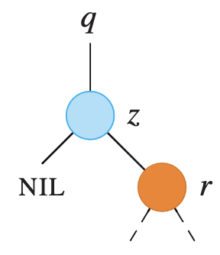
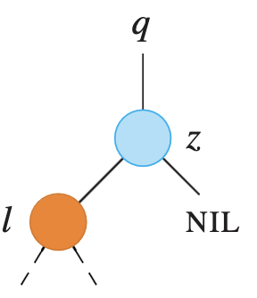
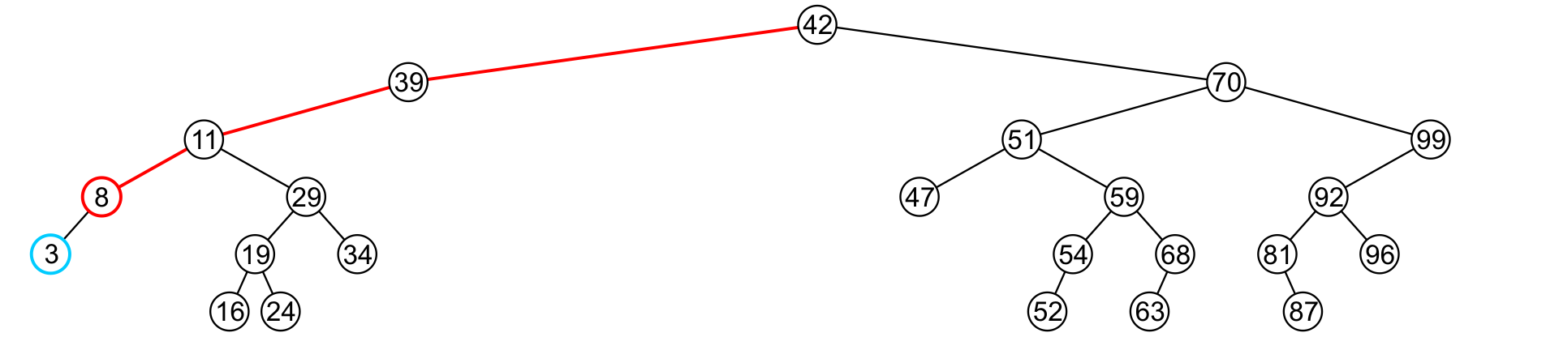
Deletion case 2: has only one child
If z has only one child

Slide 29
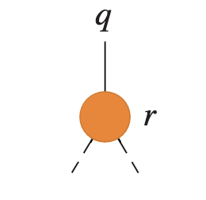
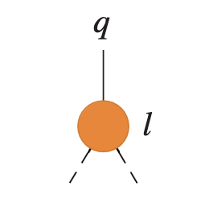
Deletion case 2: has only one child
If z has only one child
Replace z with its child

Slide 30
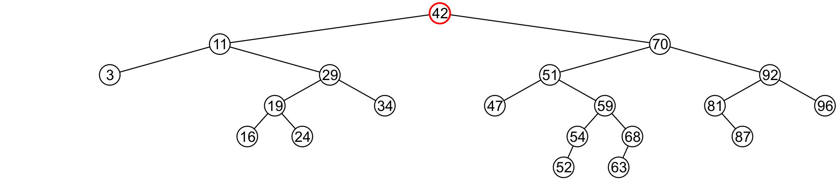
Deletion case 3: is a full node
How to delete 42 in the following?
We need to replace it with 47 and makes sure everything else is proper
Every time we delete a full node, we find its successor and replace it with the successor

Slide 31
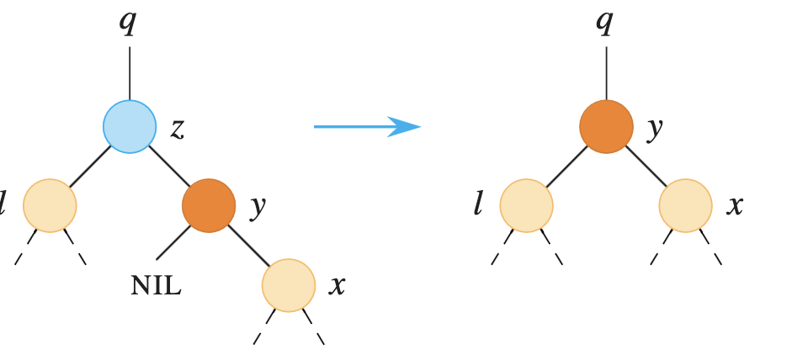
Deletion case 3a: the successor is the right child
If the successor y is the right child, we can just promote it to the upper level and replace z
Think yourself: why y only has one right child

Slide 32
Deletion case 3b: y is a leaf node
Finally, we will consider the problem of erasing a full node, e.g., 42
We will perform two operations:
Replace 42 with the minimum object in the right sub-tree
Erase that object from the right sub-tree

Slide 33
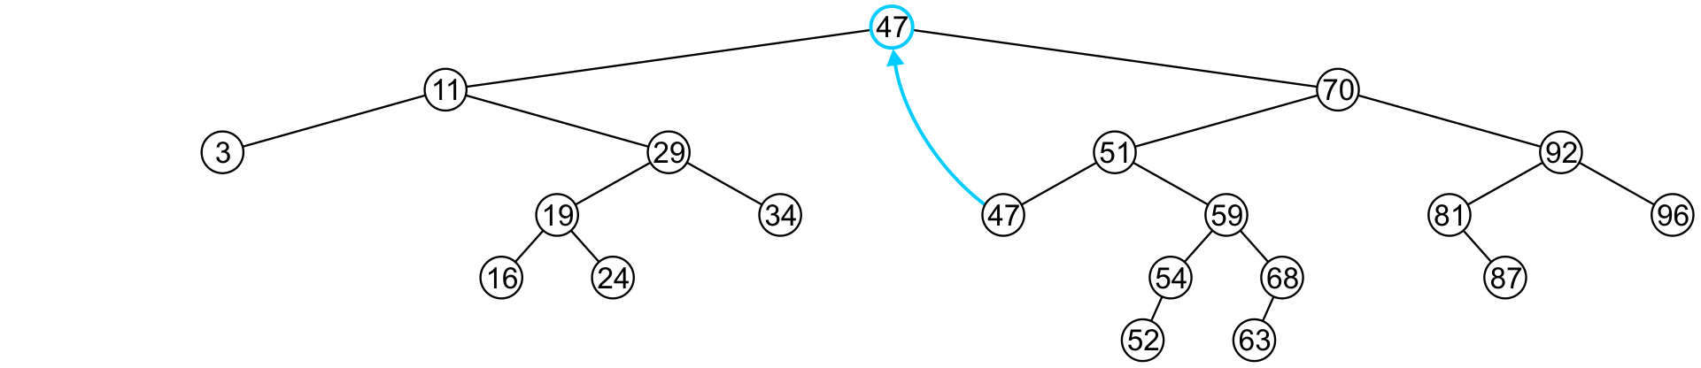
Deletion case 3b: y is a leaf node
In this case, we replace 42 with 47

Slide 34
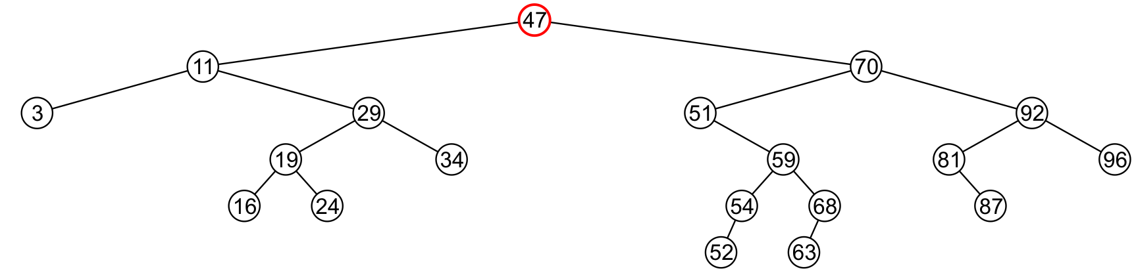
Deletion case 3c: y has right child
If the successor is somewhere in z’s right subtree and has right child
How shall we do to delete 47?

Slide 35
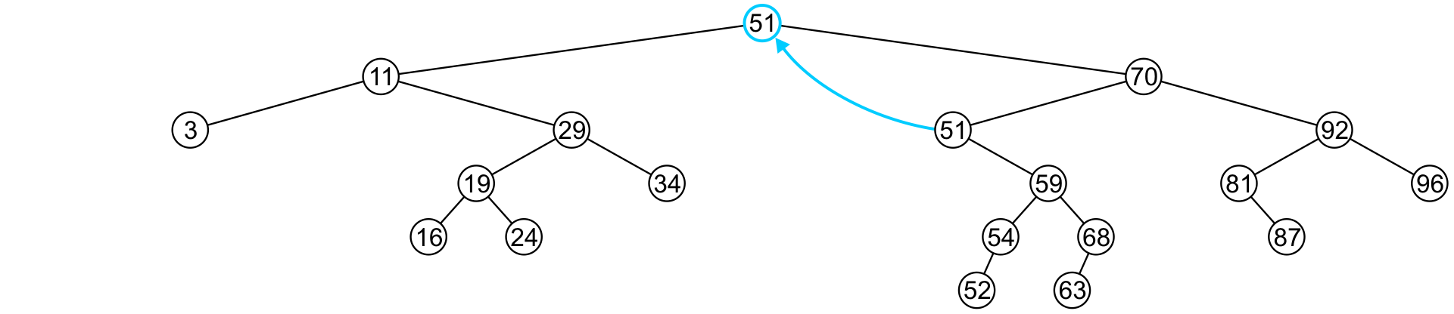
Delete 47
We copy 51 from the right sub-tree

Slide 36
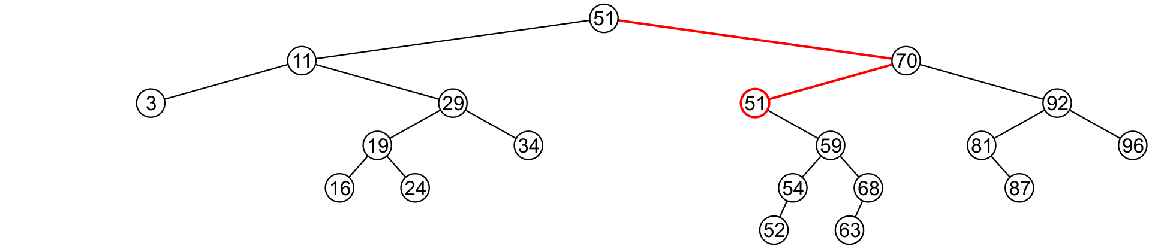
Delete 47
We must proceed by delete 51 from the right sub-tree

Slide 37
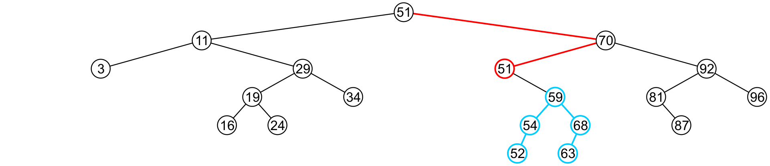
Delete 47
In this case, the node storing 51 has just a single child
Think yourself: why can’t 51 has two children?

Slide 38
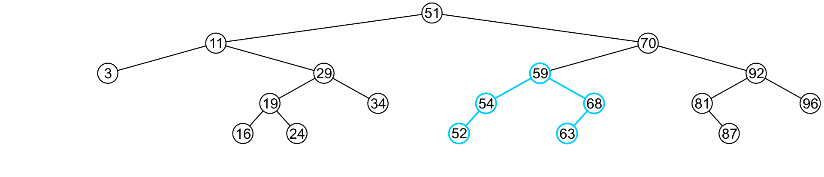
Delete 47
We delete the node containing 51 and change the left child of 70 to point to 59

Slide 39
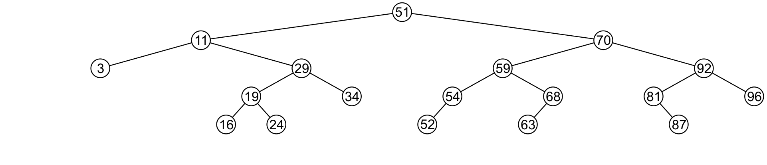
Delete 47
Note that after seven removals, the remaining tree is still correctly sorted

Slide 40
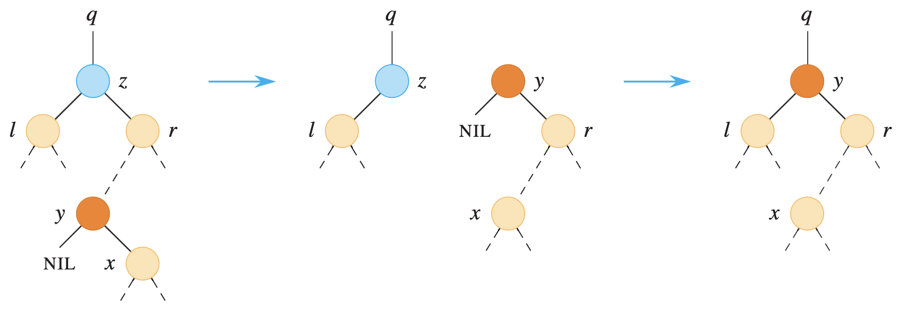
Deletion case 3
In general, if z is a full node, we want to replace it with its successor y
A: If y is z’s right child, we can just replace z with y without further changing its subtree
B and C: if not, we want to replace y with its right subtree and replace z with y

Slide 41
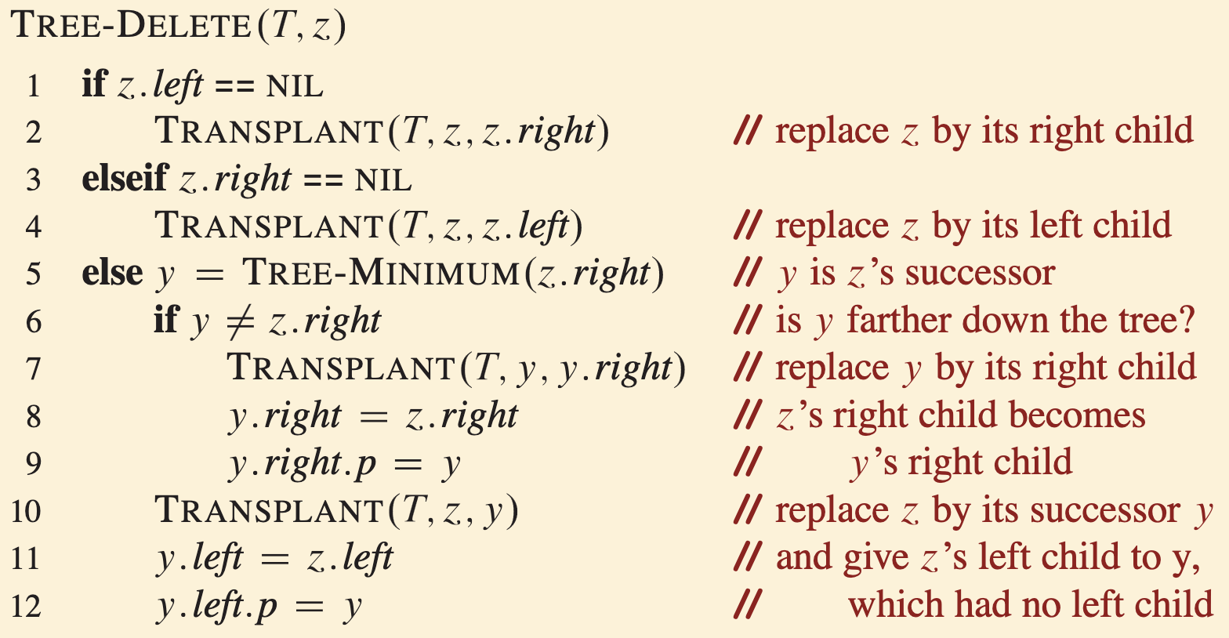
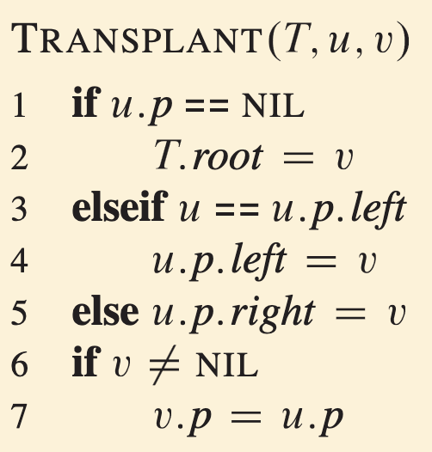
Overall deletion procedures
Overall, we can define a subroutine to transplant nodes to do replacement
Runtime?
Most lines are O(1), but we need to find minimum in line 5
O(h)

Slide 42
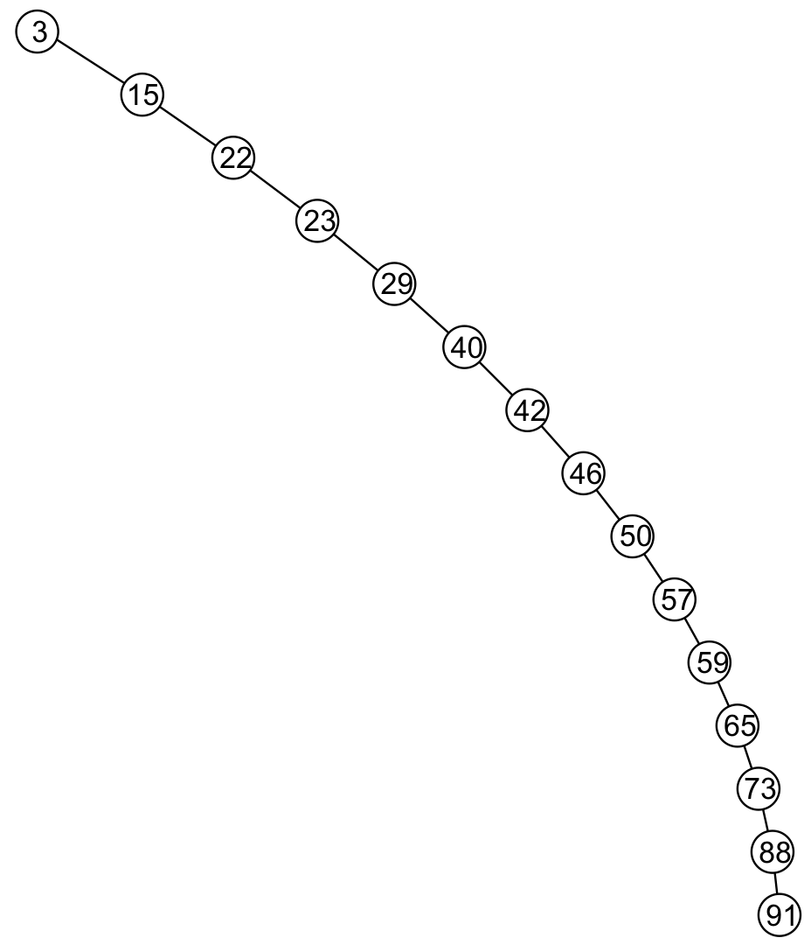

How about complexity over n?
In BST, many operations run in $O(h)$
We have no control over the height vs node size n in standard BST
Worst case is equivalent to a linked list
What if we have a balanced tree?

Slide 43
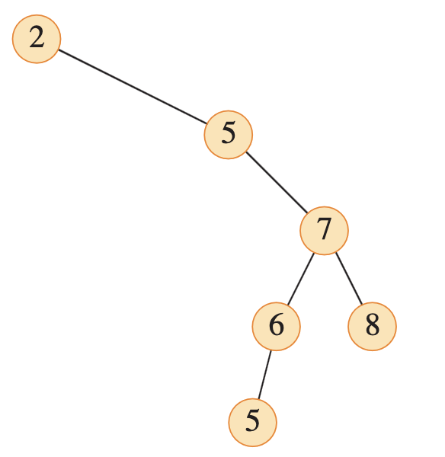
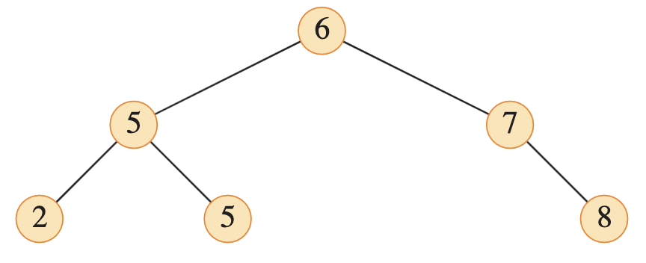
Balanced binary tree
We say a binary tree T is balanced if for every internal node u of T
The height of the left subtree of u differs from that of the right subtrees of u by at most 1
Otherwise, if any internal mode violates the requirement, we say u is imbalanced

Slide 44
The height of a balanced tree
How fast does the height h of a balanced tree grows with respect to the number of nodes n?
What is the minimum number of nodes for height h, call f(h)?
f(1) = 2 (root + 1 child)
f(2) = 4 (root + 2 children of root + at least 1 node in level 2)
f(0)
f(1)
f(2)
f(3)

Slide 45
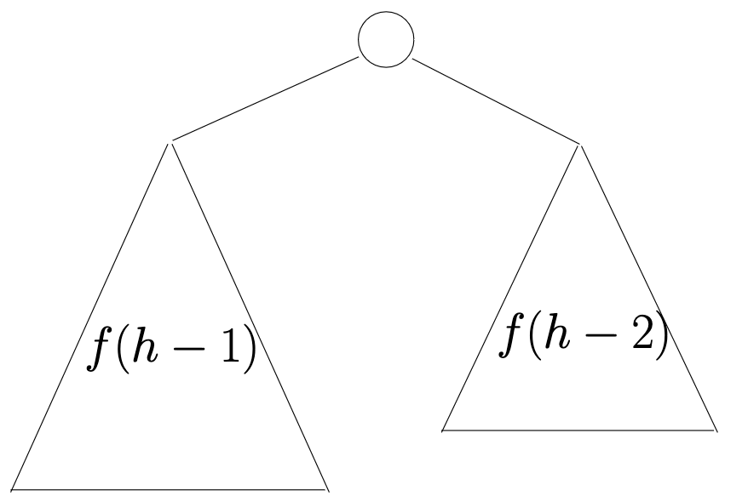


The height of a balanced tree
In general, for $h ≥ 2$,
$$f\left(h\right)=1+f\left(h−1\right)+f\left(h−2\right)$$

Slide 46
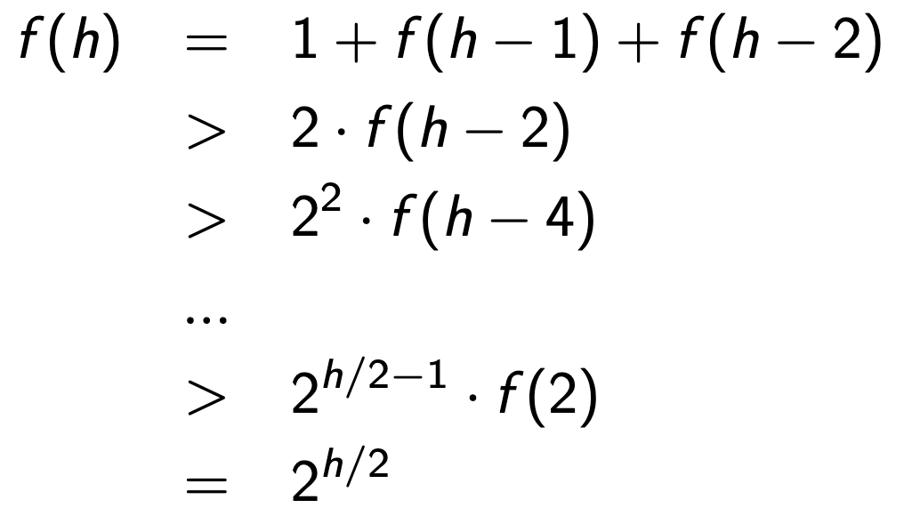

The height of a balanced tree
A balanced binary tree with $n$ nodes has height $O(log⁡n)$

Slide 47
Trade off between searching and insertion/deletion
A typical data structure is AVL tree
In real world, as long as we can keep the height under control, we can achieve O(log n)
Searching efficiency can be maximized for making the tree always balanced, but keeping the tree balanced is likely to impose extra processing costs on insertion and deletion
There are many different trees attempts to achieve the overall efficiency
We need to choose the right data structures based on the need in applications

